Slide 1
To Jesus Christ, my Lord: I can’t explain it, Lord,
But today I know you are with me. I know you hold me in
The palm of your hand. I know you love me and will guide me.
I know there is nothing you can’t do.
I know there is nothing you won’t do for me.
Amen.
In the name of the Father, the Son and the Holy Spirit.

Slide 2
Lesson 2 Ex4
Find Measurements
A. Find LM.
Point M is between L and N.
LM + MN = LN Betweenness of points
LM + 2.6 = 4 Substitution
LM + 2.6 – 2.6 = 4 – 2.6 Subtract 2.6 from each side.
LM = 1.4 Simplify.

Slide 3
Lesson 2 Ex4
Find Measurements
B. Find XZ.

Slide 4
Lesson 2 Ex4
Find Measurements

Slide 5
Lesson 2 Ex4
Find Measurements
C. Find x and ST if T is between S and U, ST = 7x, SU = 45, and TU = 5x – 3.
ST + TU = SU
7x + 5x – 3 = 45 Substitute known values.
7x + 5x – 3 + 3 = 45 + 3 Add 3 to each side.
12x = 48 Simplify.
x = 4 Simplify.

Slide 6
Lesson 2 Ex4
Find Measurements
ST = 7x Given
= 7(4) x = 4
= 28 Multiply.
Answer: x = 4, ST = 28

Slide 7
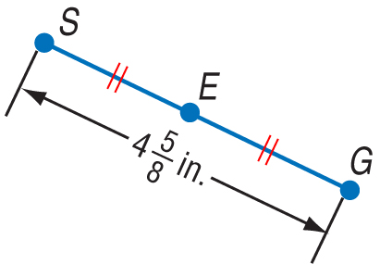
Lesson 2 CYP4
A. Find SE.
A.
B.
C.
D.
A
B
C
D

Slide 8
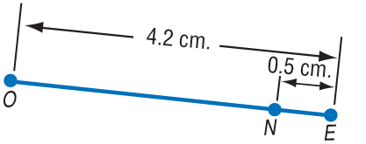
Lesson 2 CYP4
B. Find ON.
A. 4.2 cm
B. 3.7 cm
C. 4.7 cm
D. 2.1 cm
A
B
C
D

Slide 9
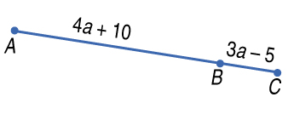
Lesson 2 CYP4
C. Find a if AB = 4a + 10, BC = 3a – 5, and AC = 19.
A. a = –15
B. a = 14
C. a = 4
D. a = 2
A
B
C
D

Slide 10
Lesson 2 KC1

Slide 11
Lesson 3 MI/Vocab
Find the distance between two points.
Find the midpoint of a segment.
midpoint
segment bisector

Slide 12
Lesson 3 KC1

Slide 13
Lesson 3 Ex1
Find Distance on a Number Line
Use the number line to find QR.
The coordinates of Q and R are –6 and –3.
QR = | –6 – (–3) | Distance Formula
= | –3 | or 3 Simplify.
Answer: 3

Slide 14
Lesson 3 CYP1
Use the number line to find AX.
A. 2
B. –8
C. –2
D. 8
A
B
C
D

Slide 15
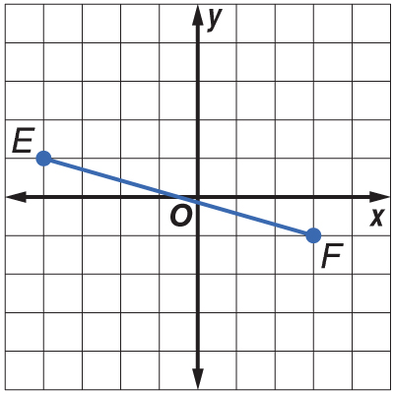
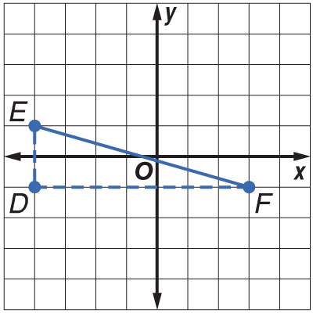
Lesson 3 Ex2
Find Distance on a Coordinate Plane
Find the distance between E(–4, 1) and F(3, –1).
Method 1 Pythagorean Theorem
Use the gridlines to form a triangle so you can use the Pythagorean Theorem.

Slide 16
Lesson 3 Ex2
Find Distance on a Coordinate Plane
.

Slide 17
Lesson 3 Ex2
Find Distance on a Coordinate Plane
Method 2 Distance Formula

Slide 18
Lesson 3 Ex2
Find Distance on a Coordinate Plane

Slide 19
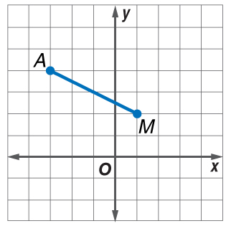
Lesson 3 CYP2
Find the distance between A(–3, 4) and M(1, 2).
A. 4
B.
C.
D.
A
B
C
D

Slide 20
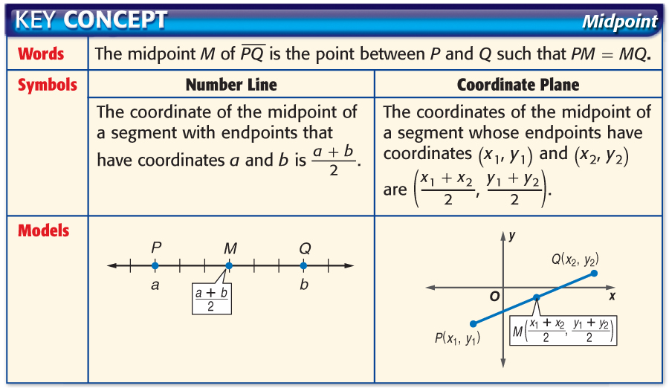
Lesson 3 KC2

Slide 21
Lesson 3 Ex3
Find Coordinates of Midpoint
ALGEBRA The coordinates on a number line of J and K are –12 and 16, respectively. Find the coordinate of the midpoint of
a = –12, b = 16
Answer: 2

Slide 22
Lesson 3 CYP3
A. –4
B. –8
C. 4
D. 22
A
B
C
D

Slide 23
Lesson 3 Ex4
Find Coordinates of Midpoint
Answer: (–3, 3)

Slide 24
Lesson 3 CYP4
A. (–10, –6)
B. (–5, –3)
C. (6, 12)
D. (–6, –12)
A
B
C
D

Slide 25
Lesson 3 Ex5
Find Coordinates of Endpoint
Write two equations to find the coordinates of D.

Slide 26
Lesson 3 Ex5
Find Coordinates of Endpoint
Answer: The coordinates of D are (–7, 11).

Slide 27
Lesson 3 CYP5
A. (3.5, 1)
B. (–10, 13)
C. (15, –1)
D. (17, –11)
A
B
C
D

Slide 28
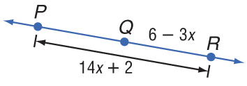
Lesson 3 Ex6
Use Algebra to Find Measures

Slide 29
Lesson 3 Ex6
Use Algebra to Find Measures
Use this equation and the algebraic measures to find a value for x.

Slide 30
Lesson 3 Ex6
Use Algebra to Find Measures
Interactive Lab: Archeology and the Coordinate Plane

Slide 31
Lesson 3 CYP6
A. 1
B. 3
C. 5
D. 10
A
B
C
D

