Slide 1
I thank You, Lord, for the Bible’s many reminders of Your complete power over all things. This truth is a source of comfort for me when I see the wicked things of our world. You have the power to orchestrate the affairs of men, nations and even the natural world so that they achieve Your grand purpose. Whatever You to do WILL happen. For that I praise Your name.
In the name of the Father, the Son and the Holy Spirit, Amen.

Slide 2
Lesson 5 MI/Vocab
Identify and use special pairs of angles.
Identify perpendicular lines.
adjacent angles
vertical angles
linear pair
complementary angles
supplementary angles
perpendicular

Slide 3
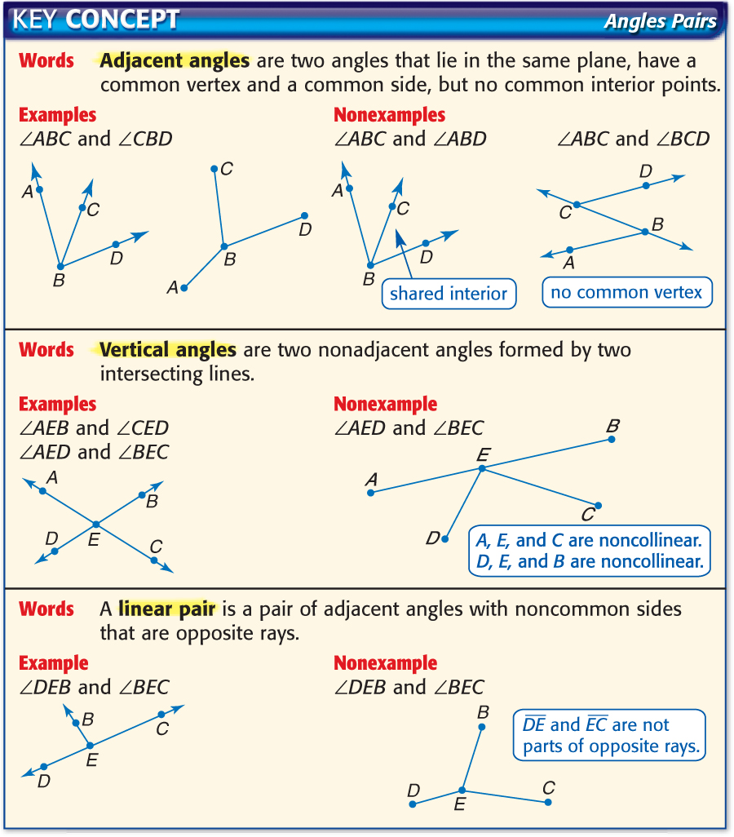
Lesson 5 KC1

Slide 4
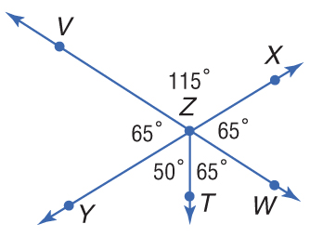
Lesson 5 Ex1
Identify Angle Pairs
A. Name two angles that form a linear pair.
A linear pair is a pair of adjacent angles whose noncommon sides are opposite rays.

Slide 5
Lesson 5 Ex1
Identify Angle Pairs
B. Name two acute vertical angles.
There are four acute angles shown. There is one pair of vertical angles.

Slide 6
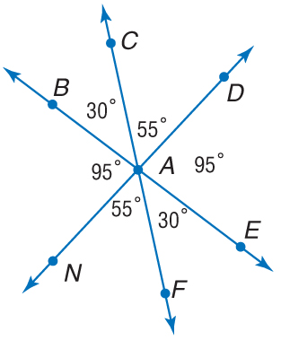
Lesson 5 CYP1
A. Name two adjacent angles whose sum is less than 90.
A. ∠CAD and ∠DAE
B. ∠FAE and ∠FAN
C. ∠CAB and ∠NAB
D. ∠BAD and ∠DAC
A
B
C
D

Slide 7
Lesson 5 CYP1
B. Name two acute vertical angles.
A. ∠BAN and ∠EAD
B. ∠BAD and ∠BAN
C. ∠BAC and ∠CAE
D. ∠FAN and ∠DAC
A
B
C
D

Slide 8
Lesson 5 KC2

Slide 9
Lesson 5 KC3

Slide 10
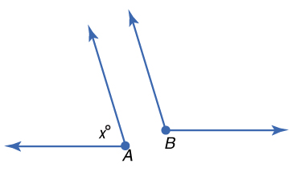
Lesson 5 Ex2
Angle Measure
ALGEBRA Find the measures of two supplementary angles if the measure of one angle is 6 less than five times the other angle.
Explore The problem relates the measures of two supplementary angles. You know that the sum of the measures of supplementary angles is 180.
Plan Draw two figures to represent the angles.

Slide 11
Lesson 5 Ex2
Angle Measure
Solve
6x – 6 = 180 Simplify.
6x = 186 Add 6 to each side.
x = 31 Divide each side by 6.

Slide 12
Lesson 5 Ex2
Angle Measure
Use the value of x to find each angle measure.
m∠A = x m∠ = 5x – 6
m∠A = 31 m∠ = 5(31) – 6 or 149
Examine Add the angle measures to verify that the angles are supplementary.
m∠A + m ∠B = 180
31 + 149 = 180
180 = 180
Answer: 31, 149

Slide 13
Lesson 5 CYP2
ALGEBRA Find the measures of two complementary angles if one angle measures six degrees less than five times the measure of the other.
A. 1°, 1°
B. 21°, 111°
C. 16°, 74°
D. 14°, 76°
A
B
C
D

Slide 14
Lesson 5 KC4

Slide 15
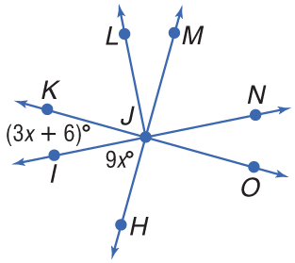
Lesson 5 Ex3
Perpendicular Lines

Slide 16
Lesson 5 Ex3
Perpendicular Lines
90 = (3x + 6) + 9x Substitution
90 = 12x + 6 Add.
84 = 12x Subtract 6 from each side.
7 = x Divide each side by 12.
Answer: x = 7

Slide 17
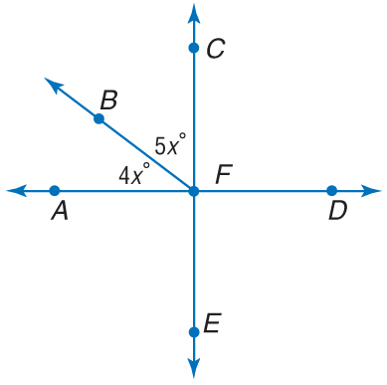
Lesson 5 CYP3
A. x = 5
B. x = 10
C. x = 15
D. x = 20
A
B
C
D

Slide 18
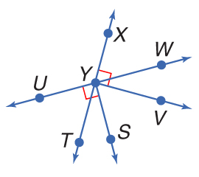
Lesson 5 Ex4
Interpret Figures
A. Determine whether the following statement can be justified from the figure below. Explain.
m∠VYT = 90

Slide 19
Lesson 5 Ex4
Interpret Figures
B. Determine whether the following statement can be justified from the figure below. Explain.
∠TYW and ∠TYU are supplementary.
Answer: Yes, they form a linear pair of angles.

Slide 20
Lesson 5 Ex4
Interpret Figures
C. Determine whether the following statement can be justified from the figure below. Explain.
∠VYW and ∠TYS are adjacent angles.
Answer: No, they do not share a common side.

Slide 21
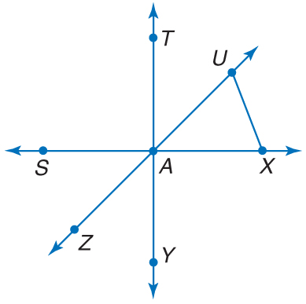
Lesson 5 CYP4
A. Determine whether the statement m∠XAY = 90 can be assumed from the figure.
A. yes
B. no
A
B

Slide 22
Lesson 5 CYP4
B. Determine whether the statement ∠TAU is complementary to ∠UAY can be assumed from the figure.
A. yes
B. no
A
B

Slide 23
Lesson 5 CYP4
C. Determine whether the statement ∠UAX is adjacent to ∠UXA can be assumed from the figure.
A. yes
B. no
A
B

