Slide 2
Lesson 4 MI/Vocab
Measure and classify angles.
Identify and use congruent angles and the bisector of an angle.
degree
interior
exterior
right angle
acute angle
obtuse angle
angle bisector
ray
opposite rays
angle
sides
vertex

Slide 3
Lesson 4 KC1

Slide 4
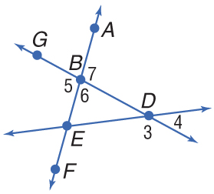
Lesson 4 Ex1
Angles and Their Parts
A. Name all angles that have B as a vertex.
Answer:

Slide 5
Lesson 4 Ex1
Angles and Their Parts
B.
Answer:

Slide 6
Lesson 4 Ex1
Angles and Their Parts
C.
Animation: Using a Protractor to Measure Three Types of Angles

Slide 7
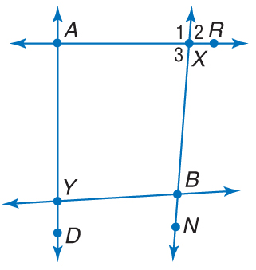
Lesson 4 CYP1
A.
A.
B.
C.
D.
A
B
C
D

Slide 8
Lesson 4 CYP1
A.
A.
B.
C.
D.
A
B
C
D

Slide 9
Lesson 4 CYP1
B.
A.
B.
C.
D. none of these
A
B
C
D

Slide 10
Lesson 4 CYP1
C.
A.
B.
C.
D.
A
B
C
D

Slide 11
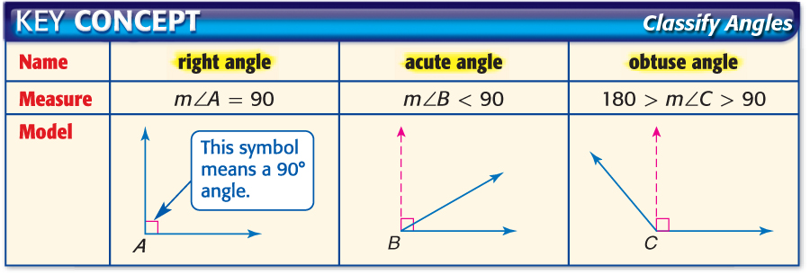
Lesson 4 KC2

Slide 12
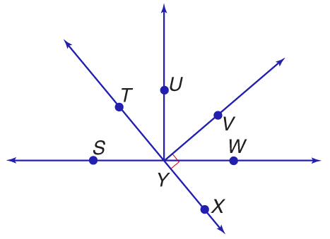
Lesson 4 Ex2
Measure and Classify Angles
A. Measure ∠TYV and classify it as right, acute, or obtuse.
Answer: m∠TYV = 90, so ∠TYV is a right angle.

Slide 13
Lesson 4 KC3

Slide 14
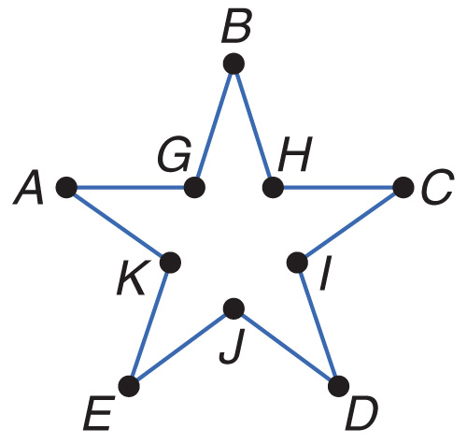
Lesson 4 Ex3
Use Algebra to Find Angle Measures
INTERIOR DESIGN Wall stickers of standard shapes are often used to provide a stimulating environment for a young child’s room. A five-pointed star sticker is shown with vertices labeled. Find m∠GBH and m∠HCI if ∠GBH ≅ ∠HCI, m∠GBH = 2x + 5, and m∠HCI = 3x – 10.

Slide 15
Lesson 4 Ex3
Use Algebra to Find Angle Measures
∠GBH ≅ ∠HCI Given
m∠GBH ≅ m∠HCI Definition of congruent angles
2x + 5 = 3x – 10 Substitution
2x + 15 = 3x Add 10 to each side.
15 = x Subtract 2x from each side.

Slide 16
Lesson 4 Ex3
Use Algebra to Find Angle Measures
Use the value of x to find the measure of one angle.
.

Slide 17
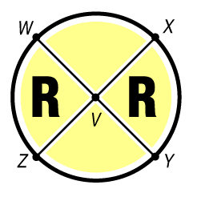
Lesson 4 CYP3
A. 11, 11
B. 90, 90
C. 80, 100
D. 80, 80
A
B
C
D

