Slide 1
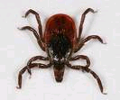
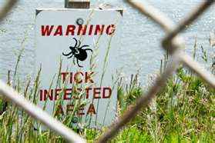
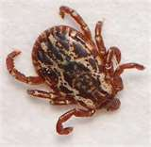
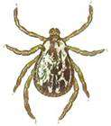
Ticks & Lyme Disease
Bureau of Workers’ Compensation
PA Training for Health & Safety (PATHS)
Ticks and Tick Borne
Diseases
Notes:
LYME DISEASE was recognized in Sweden as long ago as 1908. It was first identified in the United States in 1975, after a mysterious outbreak of arthritis among the residents of Lyme, Connecticut, hence the name. Since then, reports of Lyme disease have increased dramatically, and the disease has become an important public health problem in some areas of the United States. Approximately 20,000 new cases are reported to the CDC each year and the CDC acknowledges that 90% of cases go unreported.

Slide 2
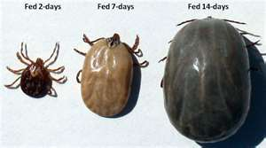
Topics
Introduction to Problem
Types
Life Cycle
Behavior
Lyme Disease
Signs & Symptoms
Evaluation
Treatment
Notes:
This program will introduce you to:
The tick problem,
Life cycle
Behavior
Lyme disease
Signs & symptoms of exposure
Evaluation of symptoms, and
Treatment

Slide 3
Why the Fuss about Ticks?
Tick populations are exploding – there’s no place in Pennsylvania without deer ticks!
Ticks are hard to kill
  “...we’ve learned that washing clothes in warm water and detergent doesn't kill all these ticks”
  “The only sure way to get rid of them is to dry clothes on high heat for a long cycle time”
  “without snow cover, these adult ticks can be active in temperatures as low as 28 degrees F”
      Steven Jacobs of Penn State Dept of Entomology,
      Penn State Ag. Sciences News 11/23/05
Ticks are becoming resistant to pesticides ???
Notes:
Tick populations in Pennsylvania are exploding.
According to Steven Jacobs of the Penn State Dept of Entomology in 2005, ticks are hard to kill.
“...we’ve learned that washing clothes in warm water and detergent doesn't kill all these ticks”
“The only sure way to get rid of them is to dry clothes on high heat for a long cycle time”
“without snow cover, these adult ticks can be active in temperatures as low as 28 degrees F”
Penn State Ag. Sciences News 11/23/05

Slide 4
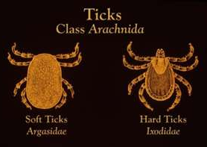
Lyme Disease
1908: recognized in Sweden
1975: first identified in Lyme Connecticut
Ticks:
Arachnids (class of Arthropods)
which includes mites, spiders
and scorpions
Two (2) groups
Hard bodied and
Soft bodied
Both capable of transmitting
disease
Notes:
Ticks are not insects but Arachnids, a class of Arthropods, which also includes mites, spiders and scorpions. They are divided into two groups - hard bodied and soft bodied - both of which are capable of transmitting diseases in the United States. Both variants are capable of transmitting diseases.

Slide 5
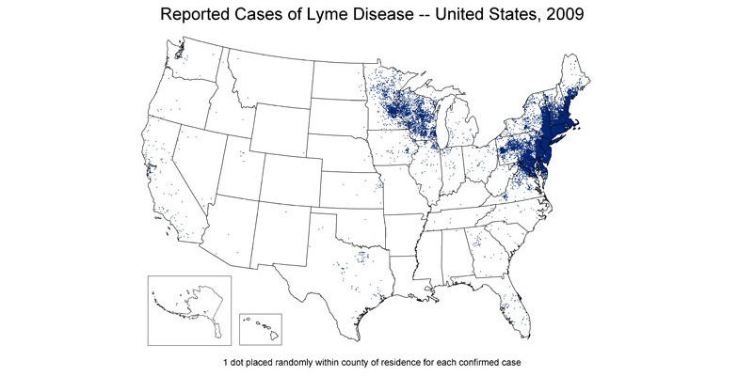
Reported Cases
CDC each year has about 20,000 new cases reported
CDC believes 90% of cases go unreported
Notes:
The Center for Disease Control has about 20,000 new cases of Lyme Disease reported each year.
Unfortunately, the CDC believes about 90% of the cases go unreported each year. Without tell-tale signs, Lyme Disease may be misdiagnosed of something else.
If the black legged tick is infected with Lyme, the transmission rate could occur:
0% @ 24hrs
12% @ 48hrs
79% @ 72hrs
94% @ 96hrs

Slide 6
For Lyme Disease to Exist
There appears to be a symbiotic relationship between:
The Lyme disease bacteria,
Ticks which can transmit them, and
Mammals to provide food for the ticks such as:
Deer and
Mice
Ticks can be found in areas with very high or low temperature with a constant high relative humidity.
Notes:
For Lyme disease to exist in an area, at least three (3) closely interrelated elements must be present in nature:
the Lyme disease bacteria,
ticks that can transmit them, and
mammals (such as mice and deer) to provide food for the ticks in their various life stages.
Ticks that transmit Lyme disease can be found in temperate regions that may have periods of
very low or high temperature and a constant high relative humidity at ground level.

Slide 7
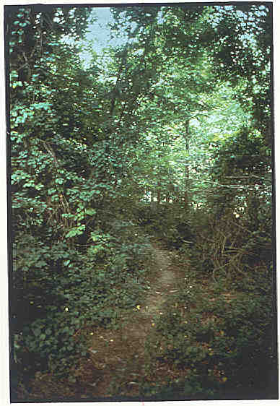
Trails & Edge Habitat
Blacklegged ticks live in woody, brushy areas that provide food and cover for hosts such as mice and deer
Exposure to these ticks can be greatest along trails and edges of woods
Notes:
Blacklegged ticks live in wooded, brushy areas that provide food and cover for white-footed mice, deer and other small or large mammals. Knowing the complex life cycle of the ticks that transmit Lyme disease is important in understanding the risk of acquiring the disease and in finding ways to prevent it.
The life cycle of these ticks requires 2 years to complete. Adult ticks feed and mate on large animals, especially deer, in the fall and early spring. Female ticks then drop off these animals to lay eggs on the ground. By summer, eggs hatch into larvae.
Larvae feed on mice and other small mammals and birds in the summer and early fall and then are inactive until the next spring when they molt into nymphs.
Nymphs feed on small rodents and other small mammals and birds in the late spring and summer and molt into adults in the fall, completing the 2-year life cycle.
Larvae and nymphs typically become infected with Lyme disease bacteria when they feed on infected small animals, particularly the white-footed mouse. The bacteria remain in the tick as it changes from larva to nymph or from nymph to adult. Infected nymphs and adult ticks then bite and transmit Lyme disease bacteria to other small rodents, other animals, and humans, all in the course of their normal feeding behavior.
Exposure to ticks may be greatest in the woods (especially along trails) and the fringe area between the woods and border.

Slide 8
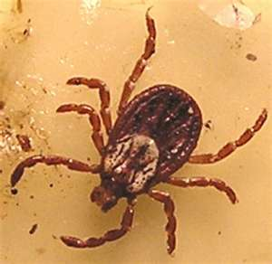
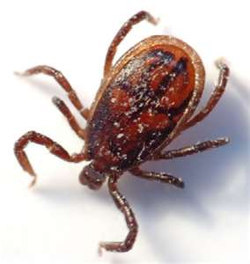
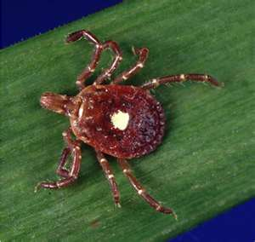
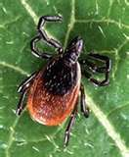
Rogue’s Gallery
Wood Tick
Brown
Dog Tick
Lone
Star Tick
Deer Tick
(Black-
legged Tick)
Notes:
This “rogue’s gallery” shows the wood tick, brown dog tick, lone star tick, and deer tick (also known as the black-legged tick).
Each has the ability to carry various diseases. Some are located exclusively in geographic regions while some have migrated to other locales.
1.Wood tick; tick paralysis, rocky mountain spotted fever
2.Brown dog tick; Q fever
3.Lone star tick; tick paralysis, Q fever, Ehrlichiosis and STARI (southern tick associated rash illness)
4.Deer tick; Lyme Disease, babesiosis, Ehrlichiosis.
Also be mindful that other vectors, such as mosquitos can also transmit lyme disease depending upon where they last took a meal.
www.lymedisease.org/lyme101/coinfections/tick_chart1.html

Slide 9
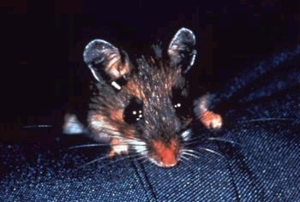
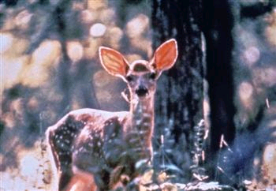


Hosts, Collaborators & Victims
Notes:
Above are various animals which can serve as a host to supply the blood meals to ticks. These can be already infected with lyme disease or be infected by ticks which feed upon them.

Slide 10
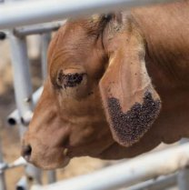
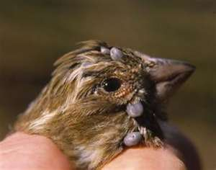
Examples of Hosts
Notes:
As you will note with the cow, above, a single tick is not just to be found but a multitude feeding.
Ticks may also be transported from location to location by using the host, such as this bird. Once the tick feeds, it can drop from the host and seek a new host for subsequent blood meals.

Slide 11
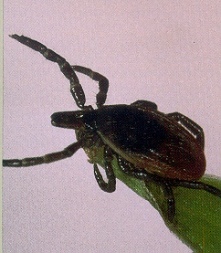
Blacklegged Tick Questing
Blacklegged ticks search
for a host from the tips of
low-growing vegetation,
generally climbing onto a
person or animal near
ground level.
Stimulated by:
Heat
Carbon dioxide
Movement
Notes:
Hard ticks seek hosts by an interesting behavior called "questing." Questing ticks crawl up the stems of grass or perch on the edges of leaves on the ground in a typical posture with the front legs extended, especially in response to a host passing by. Certain biochemicals such as carbon dioxide as well as heat and movement serve as stimuli for questing behavior. Subsequently, these ticks climb on to a potential host which brushes against their extended front legs.
Blacklegged ticks search for a host from the tips of low-growing vegetation, not from trees. Generally, ticks climb onto a person or animal near ground level.
Blacklegged ticks crawl, they do not jump or fly.
They grab onto people or animals who brush against vegetation they are sitting on and crawl upward.

Slide 12
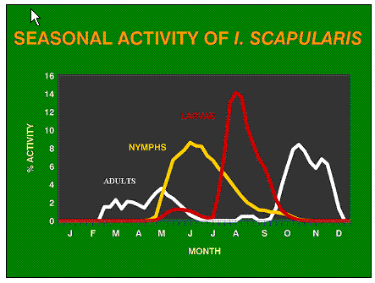
Seasonal Activity: Deer Tick
Notes:
Seasonal activity shows the more highly active time periods for the I. Scapularis (Deer tick).
Understanding this cycle can be a forewarning toward preventive measures.

Slide 13












Three Local Ticks
Dog Tick Dermacentor variabilis
Lone star tick Amblyomma americanum
Deer Tick Ixodes scapularis
Notes:
Ticks have complex two year life cycle consisting of larval, nymph and adult stages. Each stage requires a blood meal to mature into the next stage. Larvae feed on white footed mice, are the natural reservoirs in nature for many of the infectious pathogens that are then transmitted by nymphal and adult ticks to any animal they have the opportunity to feed on. Ixodes scapularis adults mate on deer. The number of ticks in the environment is directly related to the mice and deer populations.
Tick saliva has been found to contain proteins that have antihistaminic, analgesic and anti-inflammatory effects which suppress the host’s immune response to the tick bite. Many people are completely unaware of having been bitten. Some of the hitchhiking pathogens use the properties of these proteins to facilitate their successful entry into the host.
Lone Star ticks range is exploding from the south up throughout the mid-west and through the mid-Atlantic states into lower New England (LDA meeting Oct 2006, Phila). Lone stars are aggressive ticks- hunt you from 30-40 ft. away, drop out of trees.

Slide 14
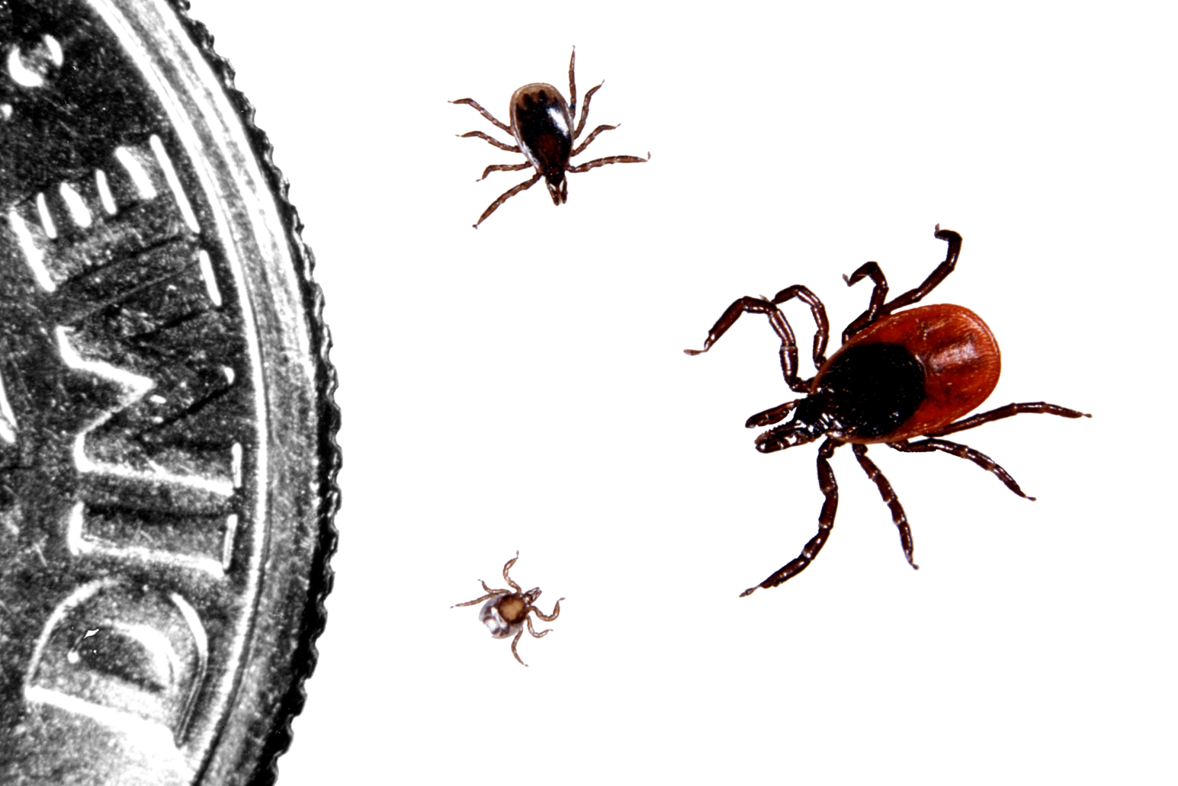
Blacklegged (Deer Ticks)
Blacklegged ticks
have three life stages
Nymph
Larva
Adult
(Female)
Notes:
Blacklegged ticks live for two years and have three blood meals. The life cycle begins when the female lays eggs. As the eggs mature, they develop into a larva (bottom), then a nymph (left) and finally, adult male or female (adult female shown on right).

Slide 15
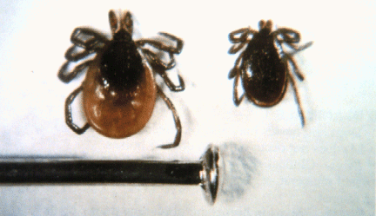
Blacklegged Tick Adults
Notes:
In the fall of the second year, nymphs molt into the reddish female (shown on the left) or the smaller male adult tick. These ticks are next to a common pin.
Male ticks attach, but do not feed. Because the males do not take a blood meal, they do not transmit Lyme disease.

Slide 16
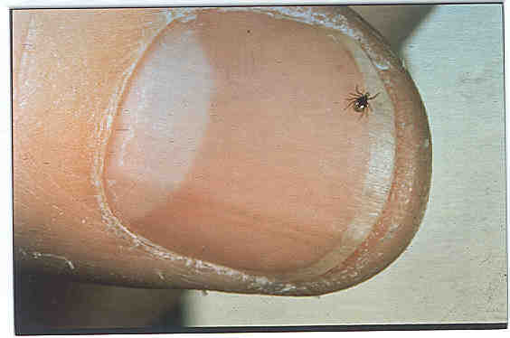
Blacklegged Tick Nymph
Notes:
In the spring and summer of the tick’s second year, primarily from May through August, the nymph becomes active and takes its second feeding from a mammal. If the tick received the bacteria from its first feeding in the larva stage, it can transmit the bacteria during this second feeding. However, if the female tick has lyme disease in its ovaries, the larval stage can transmit the disease.
Nymph stage ticks often look like a speck of dirt or a freckle on a person’s skin.

Slide 17
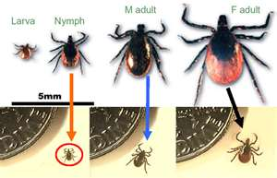
Male/Female Adult Blacklegged Tick
Feed and mate on large animals in the fall or early spring
After feeding, females lay eggs, then die
Ticks that did not feed or mate go dormant
Notes:
The deer (or blacklegged) tick in the East and the related western blacklegged tick are the only known transmitters of Lyme disease in the United States. Both are hard-bodied ticks with a two-year life cycle. Like all species of ticks, deer ticks and their relatives require a blood meal to progress to each successive stage in their life cycles.

Slide 18
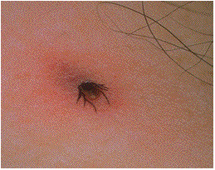
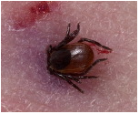
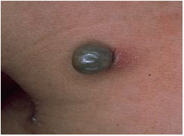
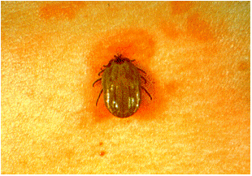
Tick Bites
Notes:
One tick bite can change your health and therefore, your life completely.
Early indicators stated that the tick would require 2 hours to 48 hours to transmit disease.
Powassen virus:
Studies with the soft-shelled tick indicated as little as 15 minutes to 30 minutes was required to transmit.
“Powassan virus was efficiently transmitted by nymphal ticks that fed for as few as 15 minutes.” (www.ajtmh.org.content/71/3/268.full)

Slide 19
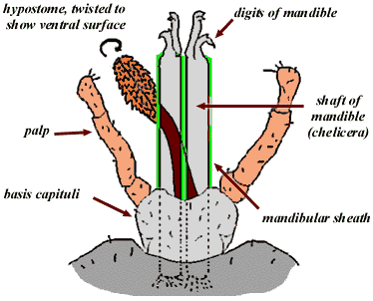
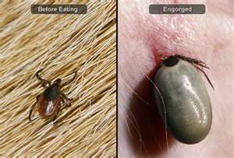
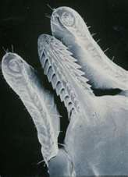
Extraction Method
Notes:
Once finding a suitable location to feed, the tick grasps the skin and cut into it with the paired chelicerae (the shaft of the mandible). After piercing the skin, the chelicerae become encased in a cement secretion to hold it in place. Due to an antihistamine material exuded, some may not even feel the tick bite. Enzymes are also released to increase blood flow.

Slide 20
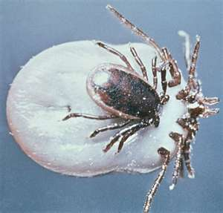
Male Tick Feeding
Male tick feeds off female.
Because male doesn’t take a blood meal from a host, the male does not transmit Lyme disease.
Notes:
Male tick feeds off female. Small meals may be taken from a host but the physical structure of the male does not allow it to become gorged as does the female.
Because male doesn’t take a blood meal from a host, the male does not transmit Lyme disease.

Slide 21
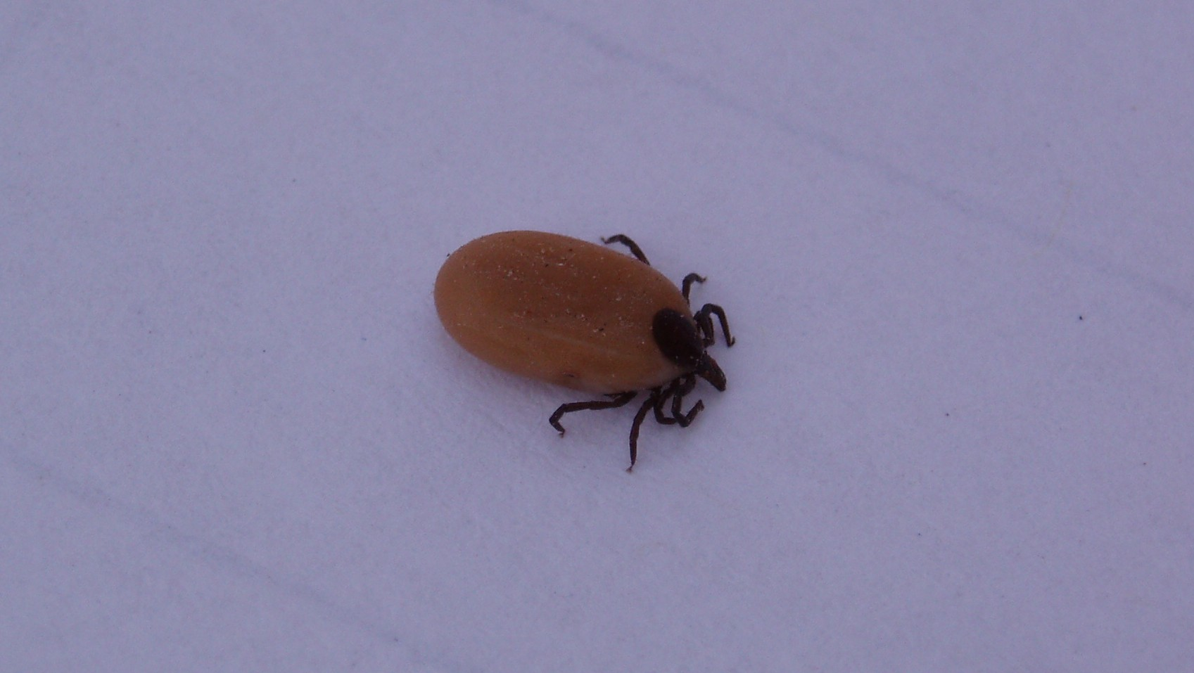
Blacklegged Tick Engorgement
Notes:
A third feeding generally occurs in late fall. As ticks feed over the course of several days, their bodies slowly enlarge with blood.
Blacklegged ticks become engorged with blood after feeding. This picture shows an adult female who has been feeding at least a few days. She is approximately the length and width of a watermelon seed. The body of the female is such that it can expand and gorge itself; the male’s body does not permit this.
Male ticks attach, but do not feed. Because the males do not take a blood meal, they do not transmit disease agents.

Slide 22
2 year Life Cycle: Blacklegged Tick
EGGS
LARVAE
MEAL 1
Mouse
Bird
NYMPHS
MEAL 2
(peak feeding
time May-mid July)
Eggs laid,
adults die
Nymphs molt into adults
Person
Mouse
Dog
MEAL 3
For adults that did not feed in fall
SPRING
SUMMER
Larvae molt into nymph stage
WINTER
FALL
Person
Deer
Dog
ADULTS
MEAL 3
Person
Deer
Dog
Nymphs dormant
Notes:
To summarize, in the spring of year one, eggs hatch into larvae, have one feeding, molt into nymphs, and go dormant. In year 2, nymphs take their second feeding. At this time, the nymph may transmit bacteria to humans, or to wild or domestic mammals.
In the fall, nymphs molt into adult male and female ticks. The females feed, mate, lay eggs, and die.

Slide 23
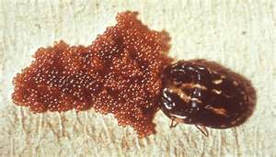
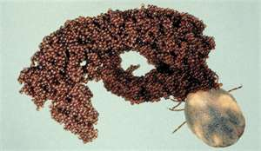
Laying Eggs
Eggs can be infected with pathogens inside the
ovaries making the new tick infectious upon birth.
Notes:
The above pictures show eggs being released by the female, often anywhere from 1,000 to 8,000 eggs at a time. Eggs can be infected with pathogens inside the ovaries making the new tick infectious upon birth.

Slide 24
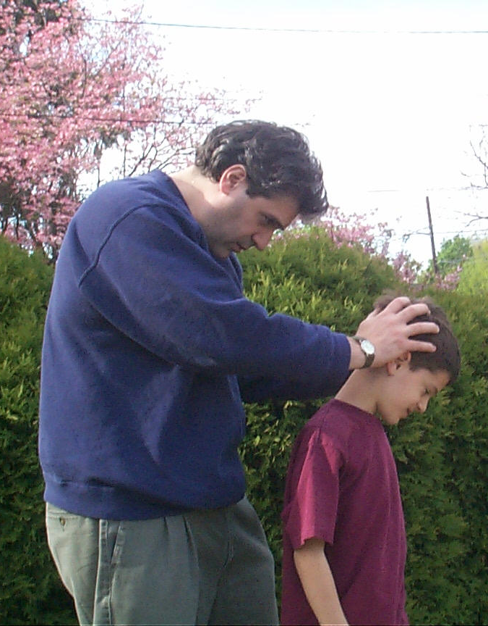

Perform Frequent Tick Checks
…while in tick habitats
And when at home!!
Notes:
If you or family members or coworkers have entered tick-prone habitats, perform a survey upon leaving to find and remove ticks. In some instances, field workers for game commissions have found anywhere from 100 to 200 ticks on their person upon leaving the woods.
Perform a tick “decon” (decontamination) survey before getting back into vehicles or before going home.
Once back at the work station or home, look again to make sure you’re absent ticks.

Slide 25
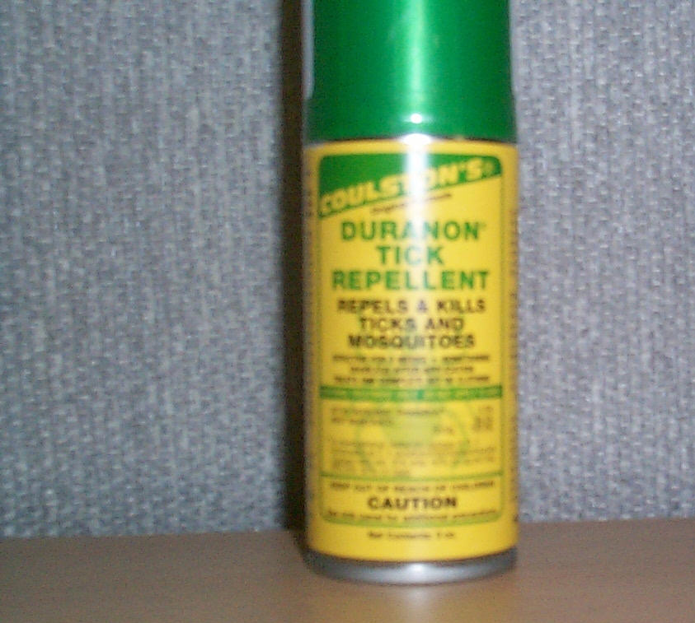
Tick Repellents for Personal Use
Permethrin-containing products
Use on Clothing Only
Insect repellent (DEET)
Insecticide
Follow Directions Carefully
Notes:
Permethrin containing products can only be used on outerwear clothing. Always follow the product instructions for using tick repellents.

Slide 26
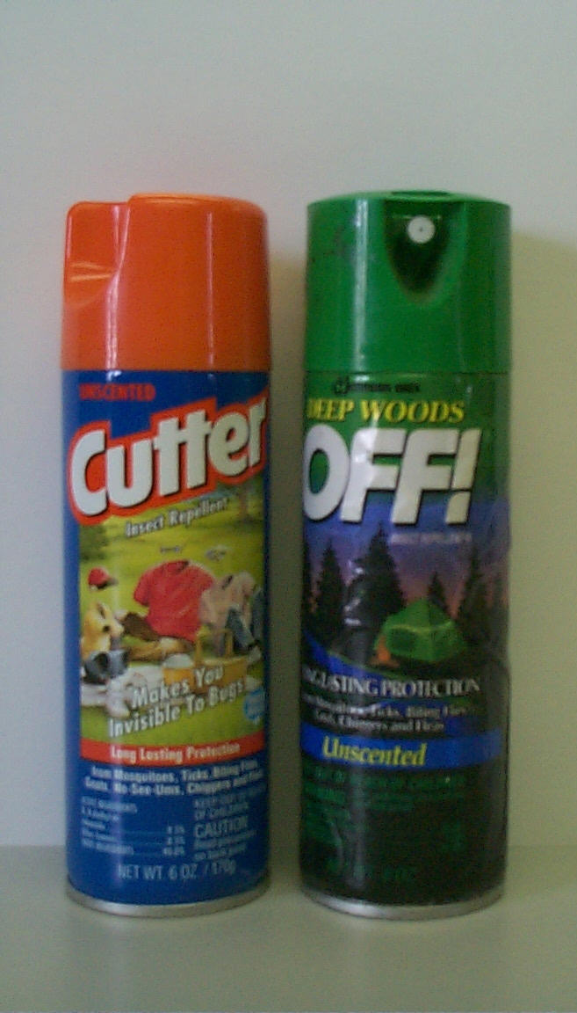
Tick Repellents for Personal Use
30% - 40% DEET content most effective for ticks
Use on skin or clothing
Target shoes, pant legs
Not for children < 3 yrs
See guidelines for children
FOLLOW DIRECTIONS CAREFULLY
Notes:
DEET is another effective tick repellent that can be applied to the skin and your clothing. Again always follow the instructions on the label when using these products.

Slide 27
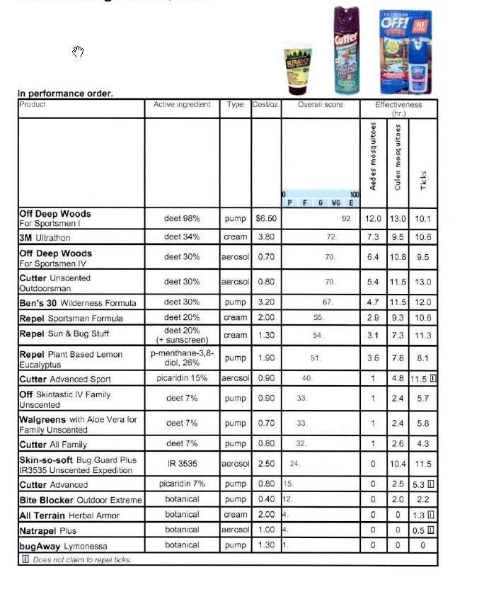
Various Repellents
Notes:
As indicated on the screen the products with the arrows beside them have been identified by consumer reports to be the most effective DEET products in regards to tick repellent.

Slide 28
Picaridin
World Health Organization (WHO) 2000 recognized effectiveness of Picaridin
In some tests, more effective than DEET
Effective in field and lab tests against:
Common tick (sheep, pasture or castor-
bean tick)
Deer tick (carrier of Lyme Disease)
Brown dog tick
www.picaridin.info
Notes:
World Health Organization (WHO) 2000 recognized effectiveness of Picaridin.
In some tests, Picaridin proved more effective than DEET.
Effective in field and lab tests against:
Common tick (sheep, pasture or castor-bean tick)
Deer tick (carrier of Lyme Disease)
Brown dog tick

Slide 29
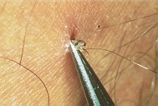
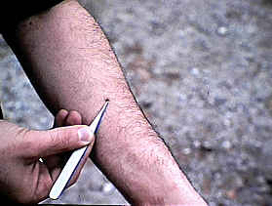
Proper Tick Removal
Use fine-point tweezers or tick removal tool
Grasp close to skin
Pull gently
Wash area with soap, water and antiseptic
Do not use gasoline or match
Do not use Vaseline
Never use products such as soap or finger nail polish to try and remove a tick - this will trigger injection of the salivary glands and disease causing microbes into the feeding source
Notes:
Use fine-tipped tweezers to remove a tick. If you don't have tweezers, put on gloves or cover your hands with tissue paper, then use your fingers. Do not handle the tick with bare hands. • Grab the tick as close to its mouth as you can. The body of the tick will be above your skin.
Do not grab the tick around its bloated belly. You could push infected fluid from the tick into your body if you squeeze it.

Slide 30
Tick-Borne Diseases
Ticks may carry other pathogens, rickettsia,
bacteria, viruses and protozoa:
Rocky Mountain spotted fever
Tularemia
Colorado tick fever
Crimean-Congo hemorrhagic fever
Lyme disease
Notes:
Ticks may carry other pathogens, rickettsia, bacteria, viruses and protozoa. Some other diseases include:
Rocky Mountain spotted fever
Tularemia
Colorado tick fever
Crimean-Congo hemorrhagic fever
Lyme disease

Slide 31
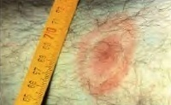
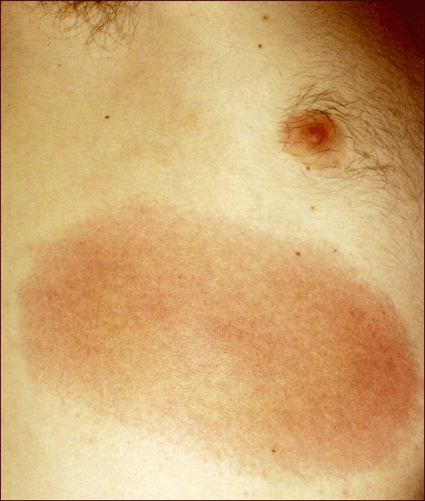
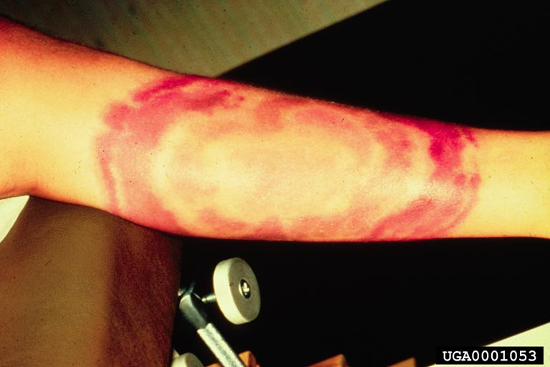
Lyme Rashes & Recognition
Classic Bull’s Eye
Large rash on chest
Large rash on Arm
Notes:
Lyme rashes come in all shapes and sizes. The most common is the bulls eye rash but the next few slides show actual rashes caused by lyme disease and their co-infections. Sometimes the rash does not have a bull’s eye appearance. It may appear as a reddened area without an outer ring.
Lyme disease is not transmitted from person to person.
Not everyone gets a rash with Lyme disease.
The early signs and symptoms of Lyme disease (fever, chills, headache, muscle/joint pain and fatigue) are similar to other ailments. Therefore, it may be difficult to diagnose Lyme disease if a person does not have the rash.

Slide 32
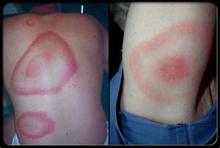
Lyme Rashes
Typical “bulls eye” rash
Several concentric circles
Expands over time
Raised or flat
May be warm
Can be painful, painless or itchy
Notes:
Typical “bulls eye” rash is several concentric circles
Expands over time
Raised or flat
May be warm
Can be painful, painless or itchy
You may also have contracted Lyme Disease without displaying this concentric circle.

Slide 33
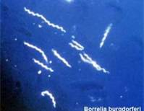
Lyme Bacteria
Symptoms:
Fever
Chills
Headache
Muscle pain
Joint pain
Fatigue
Bacteria
(Borrelia burgdorferi)
Notes:
Symptoms of Lyme Bacteria include:
Fever
Chills
Headache
Muscle pain
Joint pain
Fatigue
The picture above shows the spirochetes of the bacteria, Borrelia burgdorferi

Slide 34
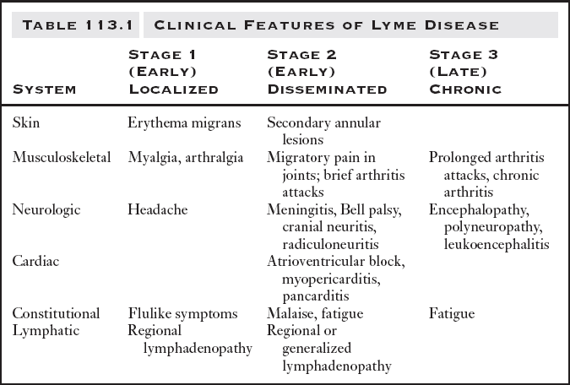
Lyme Disease: Clinical Features
Notes:
Some of the above clinical features are furnished for you to review on your own. Please note that each systemic area presents its own unique clinical features for Lyme Disease

Slide 35
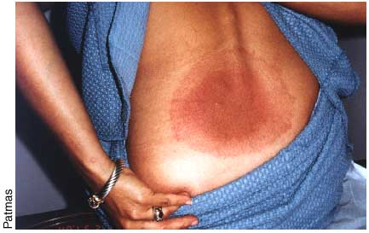
Lyme Rashes
Large rash with gradual change of color intensity
Notes:
Lyme rashes can change color intensity as the bacteria moves through your system.

Slide 36
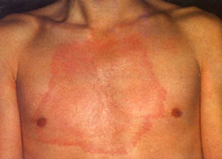
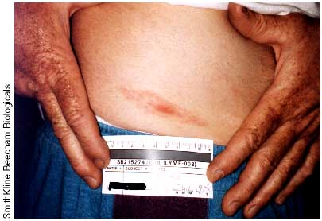
Lyme Rashes
Rashes are not always circular.
Notes:
The Lyme rashes are not always circular as shown above.

Slide 37
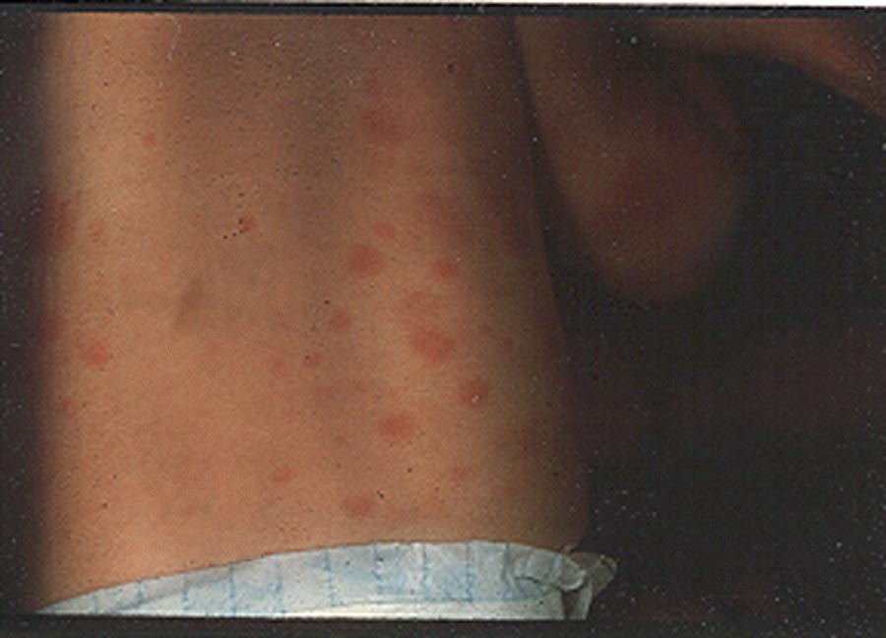
Lyme Rashes
Notes:
Swelling can also occur as well as the presentation of co-infections which would first need to be remedied before successfully treating the Lyme Disease.

Slide 38
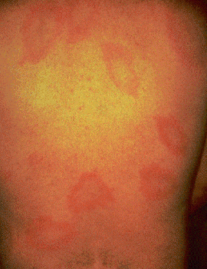
Multiple Rashes
Reaction as bacteria move through body
Not caused by multiple tick bites
Notes:
A person may experience multiple rashes, such as you see here. The rash is not caused from multiple tick bites, but occurs as a reaction when the bacteria move through the body.

Slide 39

Multiple Rashes
Notes:
This is another example of a multiple rash on an infant.

Slide 40

Lone Star Larval Bites
Bites from multiple larval Lone Star ticks acquired at Aberdeen Proving Grounds
courtesy of
Sandra Evans, US Army
Notes:
Bites from multiple larval Lone Star ticks acquired at Aberdeen Proving Grounds
(Courtesy of Sandra Evans, US Army)

Slide 41

Co-Infection Bartonella Rashes
Linear rashes –
look like stretch marks clinically associated with gastritis
Photos taken by Dr. Martin Fried, with thanks to the Lyme Disease Association
Notes:
Linear rashes – look like stretch marks clinically associated with gastritis.
Photos taken by Dr. Martin Fried, with thanks to the Lyme Disease Association

Slide 42

Joint Swelling
Joint swelling and pain may occur weeks to months after onset of illness if left untreated
Joint swelling of the knee(s) is a common symptom
Notes:
This is an example of Lyme arthritis in the knee. Joints may become red, swollen, and painful within weeks to months after an onset of illness if left untreated. Lyme arthritis is generally periodic, but may become chronic in about 10 percent of people if untreated.

Slide 43
Misconception
“Tick needs to be attached more than 24 hours before infection is transmitted.”
  Published literature reports anywhere from 2 to 48 hours
  Scientific knowledge of the interactions between tick saliva, tick pathogens, the host immune system is incredibly complex
  What duration of tick attachment would permit assumption of zero risk of transmission?
        None!
Notes:
Previous thought was that the tick must be attached for 24-48 hours until an individual could get Lyme Disease. This thought has been proved to be false an indicated earlier.
Published literature reports anywhere from 2 to 48 hours
Scientific knowledge of the interactions between tick saliva, tick pathogens, the host immune system is incredibly complex
What duration of tick attachment would permit assumption of zero risk of transmission?
None!

Slide 44
Truth
Less than 50% patients with tick borne disease even remember a tick bite
Of those who do remember a tick bite, only roughly half have an erythema migrans (EM) rash
  EM rashes are extremely variable - not being recognized by doctors or patients
  Rashes are dismissed or misdiagnosed
Co-infections go undiagnosed and untreated
“Watchful waiting” after any tick bite is not wise-seek medical help
Notes:
Less than 50% patients with tick borne disease even remember a tick bite.
Of those who do remember a tick bite, only roughly half have an erythema migrans (EM) rash
EM rashes are extremely variable - not being recognized by doctors or patients
Rashes are dismissed or misdiagnosed.
Coinfections go undiagnosed and untreated.
“Watchful waiting” after any tick bite is not wise-seek medical help.

Slide 45
Lyme Disease: Signs/Symptoms
Extreme fatigue, often interfering with activities
Headaches of all types
Recurrent fevers, chills, night sweats
Myalgias and arthralgias; either may be migratory
Muscle fasciculations (twitching)and weakness
Paresthesias and neuropathic pain syndromes
Sleep disturbances
Cranial nerve dysfunction
Notes:
The symptoms of Lyme disease are widespread and variable; relapsing/remitting patterns are common. The validity of individual symptoms has been documented in numerous reports and studies on Lyme disease.
The signs and symptoms of Lyme disease can vary among individuals.
Three (3) to 30 days after a bite from an infected deer tick, look for:
A distinctive rash (“bulls-eye” or erythema migrans)
Fever
Chills
Headache
Muscle and joint pain
Fatigue
Swollen lymph nodes
A person may not have all of these symptoms. People often feel like they have the “flu.”

Slide 46
More Signs & Symptoms
Neuropsychiatric problems: irritability, depression, anxiety, panic attacks, new onset ADHD, mood swings similar to bipolar disease, rage attacks, OCD (Obsessive-Compulsive Disorder)
Cognitive losses: memory impairment, difficulty multi-tasking, slowed mental processing, speech and language problems, poor concentration, loss of math skills, impaired visual/spatial processing
Children may have behavioral changes, declining school performance, headache, fatigue, forgetfulness, complex partial seizures, depression and be misdiagnosed with primary ADHD
Notes:
Other problems arise due to co-infections to Lyme Disease:
Neuropsychiatric problems,
Cognitive losses and memory impairment.
Children may have behavioral changes which can often be misdiagnosed as ADHD=Attention deficit hyperactivity disorder.

Slide 47
Co-infections
Co-infections are the rule, not the exception
“80% of my pediatric patients are co-infected”
Co-infections are often best diagnosed clinically
Co-infected patients are:
  Sicker
  More likely to have failed prior treatment
  Require longer treatment with multiple agents
Co-infections must be eradicated or Borrelia infection will persist
Notes:
Co-infections are the rule, not the exception
“80% of my pediatric patients are co-infected”
Co-infections are often best diagnosed clinically
Co-infected patients are:
Sicker
More likely to have failed prior treatment
Require longer treatment with multiple agents
Co-infections must be eradicated or Borrelia infection will persist

Slide 48

Co-infections
Notes:
Other co-infections include
1.Babesiosis and
2.Bartonellosis each with their respective symptoms

Slide 49
Evaluation
“If false results are to be feared, it is the false negative result which holds the greatest peril for the patient.”
Gestational Lyme Borreliosis. Implications for the fetus. MacDonald, AB, Rheum Dis Clin North Am 1989; 15(4): 657-77.
Ann F Corson, MD
Notes:
Evaluation:
“If false results are to be feared, it is the false negative result which holds the greatest peril for the patient.”
Gestational Lyme Borreliosis. Implications for the fetus. MacDonald, AB, Rheum Dis Clin North Am 1989; 15(4): 657-77.

Slide 50


Lyme Testing
One type of test that is often prescribed by the attending provider during the first step of diagnosis is the ELISA or IFA test
ELISA: Enzyme-Linked Immunosorbent Assay
Notes:
One type of test that is often prescribed by the attending provider during the first step of diagnosis is the ELISA or IFA test
ELISA: Enzyme-Linked Immunosorbent Assay

Slide 51
Lyme Testing
The second type of test and the one many feel is the most preferred uses an immunoblot (this is the Western blot or striped blot test)
Sometimes two types of Western blot are performed: "IgM" and "IgG"
Patients who test positive by IgM but not IgG should have the test repeated a few weeks later if they remain ill
Notes:
2) The second step uses an immunoblot such as a Western blot or striped blot test. Used appropriately, this test is designed to be "specific," meaning that it will usually be positive only if a person has been truly infected. If the Western blot is negative, it suggests that the first test was a false positive, which can occur for several reasons.
Sometimes two types of Western blot are performed, "IgM" and "IgG." Patients who are positive by IgM but not IgG should have the test repeated a few weeks later if they remain ill. If they are still positive only by IgM and have been ill longer than one month, this is likely a false positive.

Slide 52
Treatment
Antibiotics such as:
  Doxycycline
  Amoxicillin
  Ceftin
Usually treated for 4-6 weeks
A recent study of in the New England Journal of Medicine indicates that a four-week course of oral doxycycline is just as effective in treating late LD, and much less expensive, than a similar course of intravenous Ceftriaxone (Rocephin) unless neurological or severe cardiac abnormalities are present
Notes:
Lyme disease is treated with antibiotics under the supervision of a physician. Several antibiotics are effective. Antibiotics usually are given by mouth but may be given intravenously in more severe cases.
Antibiotics such as:
Doxycycline
Amoxicillin
Ceftin
Usually treated for 4-6 weeks.
A recent study of in the New England Journal of Medicine indicates that a four-week course of oral doxycycline is just as effective in treating late LD, and much less expensive, than a similar course of intravenous Ceftriaxone (Rocephin) unless neurological or severe cardiac abnormalities are present

Slide 53

Testing Ticks
Some state or local health departments offer tick identification and testing
Check your local jurisdiction for such a service
Notes:
Testing Ticks
Patients who have removed a tick often wonder if they should have it tested. In general, the identification and testing of individual ticks is not useful for deciding if a person should get antibiotics following a tick bite. Nevertheless, some state or local health departments offer tick identification and testing as a community service or for research purposes. Check with your health department; the phone number is usually found in the government pages of the telephone book.
Under new PA legislation, the PA Dept of Health will be the agency tasked with Tick-Borne Disease Surveillance to determine if ticks are infected. (Senate Bill No. 177)

Slide 54

Tips
Be aware of your surroundings
Limit time in tick-infested areas
Use proper protection:
Clothing
Sprays
Check for their presence after leaving area
If found, remove properly and seek medical advice
Notes:
In summary:
Be aware of your surroundings
Limit time in tick-infested areas
Use proper protection:
Clothing
Sprays

Slide 55
Websites of Interest
www.ilads.org
www.lymepa.org
www.lymediseaseassociation.org
www.thehumansideoflyme.net
www.lymeinfo.net/lymefiles.html
  www.lymeinfo,net/medical/LDPersist.pdf
  www.lymeinfo.net/medical/LDSymptoms.pdf
  www.lymeinfo.net/medical/LDSupplement.pdf
  www.lymeinfo.net/medical/LDSeronegativity.pdf
  www.lymeinfo.net/medical/LDCysts.pdf
  www.lymeinfo.net/medical/LDAdverseConditions.pdf
  www.lymeinfo.net/medical/LDBibliography.pdf

Slide 56


Contact Information
Health & Safety Training Specialists
1171 South Cameron Street, Room 324
Harrisburg, PA 17104-2501
(717) 772-1635
RA-LI-BWC-PATHS@pa.gov
Like us on Facebook! - https://www.facebook.com/BWCPATHS

Slide 57

Questions

